Slide 1

Temporal Phi-4 on Lattice
Xuanqi Wang

Slide 2
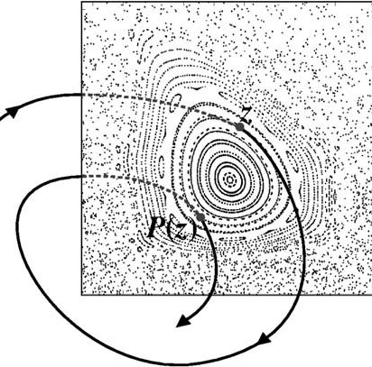

What is phi-4
Defined on a discrete 1-d lattice
Discretized flow: differential $→$ difference
$φ_{t+1}−2φ_{t}+φ_{t−1}=μ^{2}({−φ}_{t}^{3}+φ_{t})$
Deterministic field theory

Slide 3
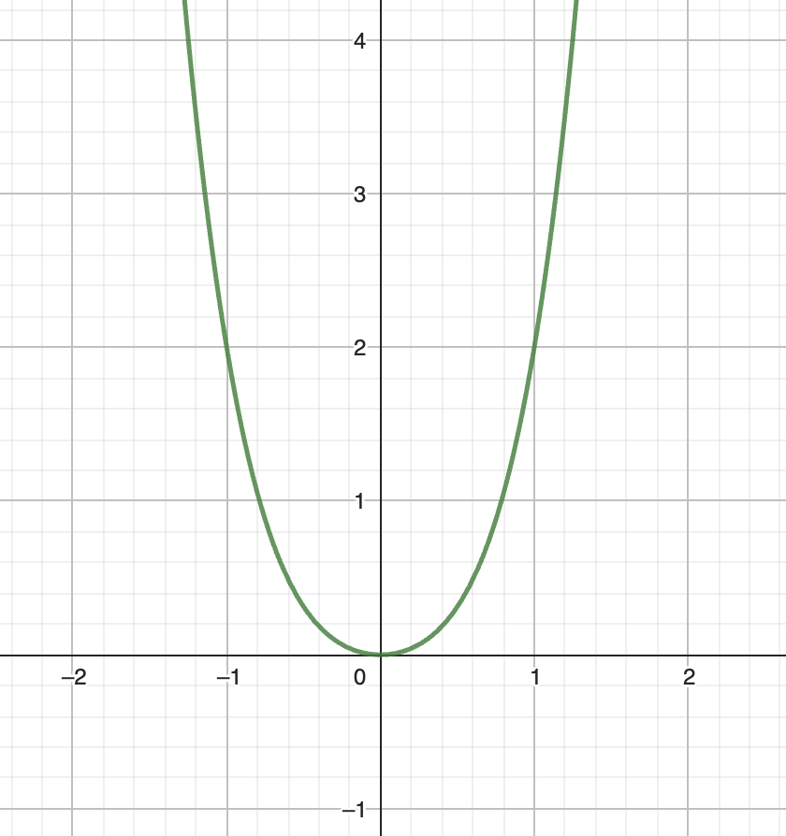
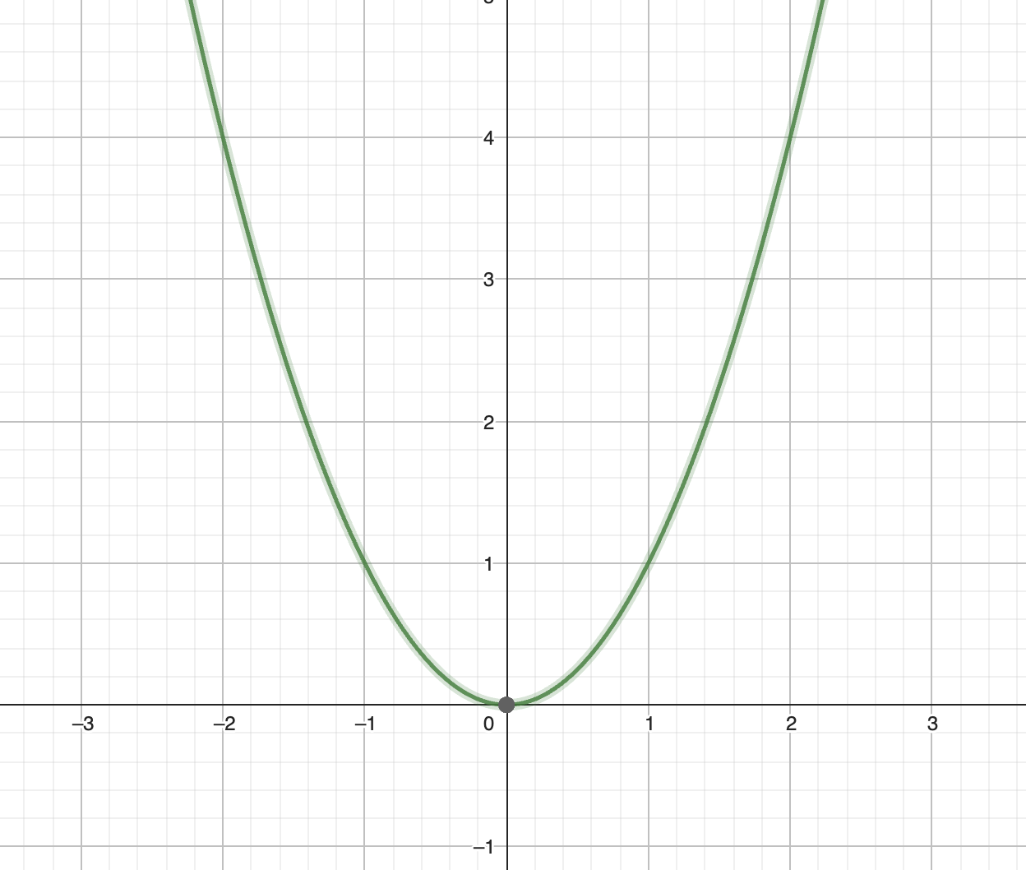
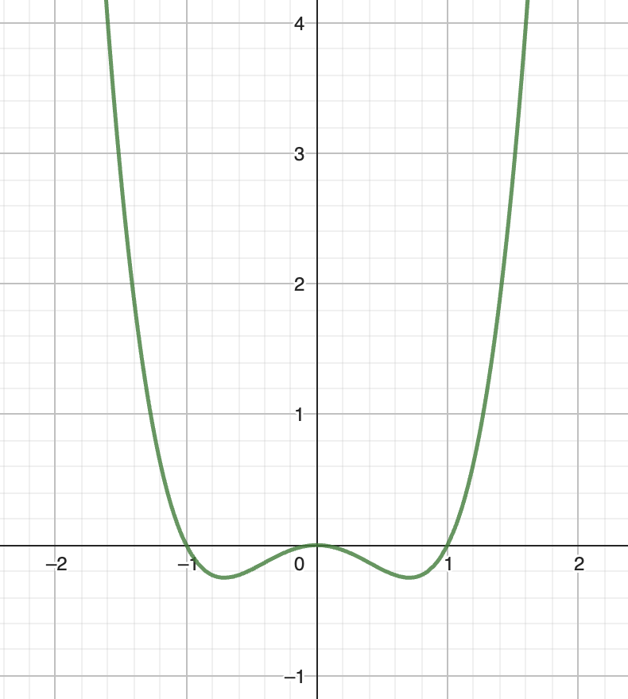

Why are we interested
Start from harmonic oscillator $V\left(x\right)∝x^{2}$
Preserved symmetry: $V\left(x\right)=ax^{4}+bx^{2}+c$ (set c=0)
Saddle point

Slide 4
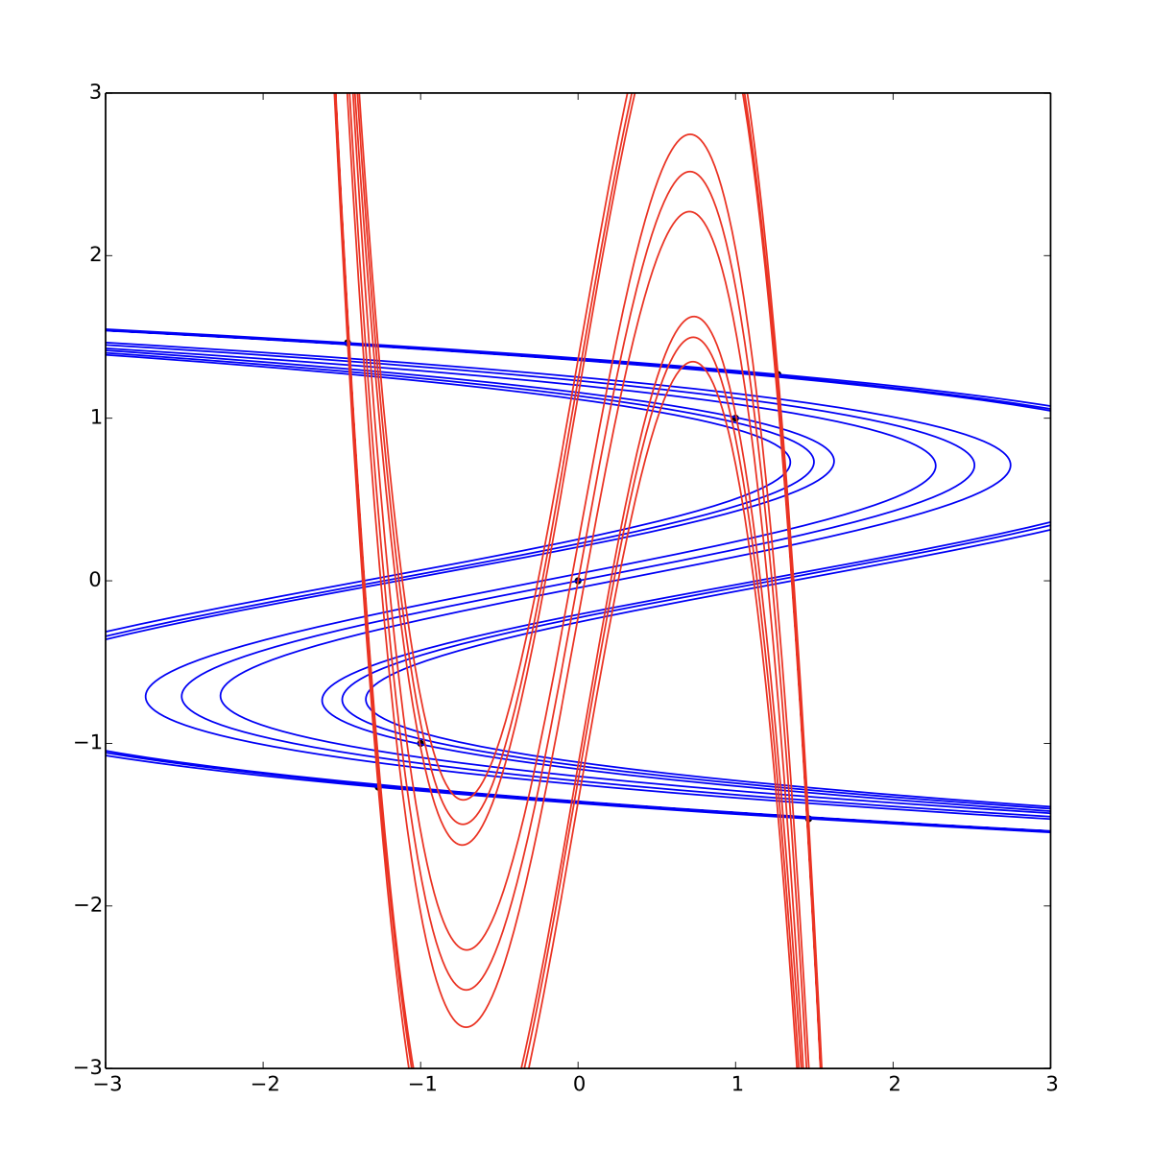
How to study it?
Discretized dynamical system: we use interations instead of time propagation
Stable-unstable manifold as “invariant subspaces”
Non-wondering set and fixed points

Slide 5
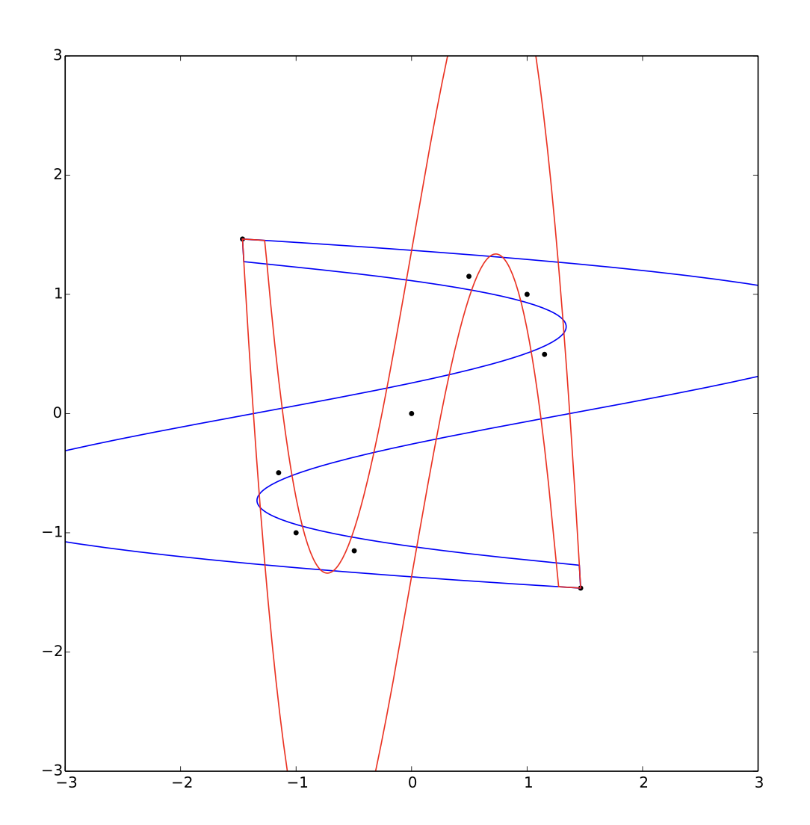
Some geometry
Non-wondering set as a fractal
Prime orbits and their repeats: always in the non-wondering set
Discrete symmetries in state space: orbits come in pairs and have the same dynamical properties

Slide 6
Future work
Reduce symmtries to fundamental domain
Find generating functions that are characteristic for desired symmetry
Improve efficiency of realted algorithm using transition graph
Relate the stability of neighboring orbits in state space

